Slide 1

H Anarghya - 1BM17IS028
Pannaga Sharma M L - 1BM17IS053

Slide 2

Objective
1
To make the existing billing system fast, reliable, convenient, informative and to increase the efficiency.
SUPERMARKET BILLING SYSTEM
2
To show cross language interoperability between C# and C++.
3
To understand the advantages of the .NET platform which uses a common runtime engine for all languages.

Slide 3
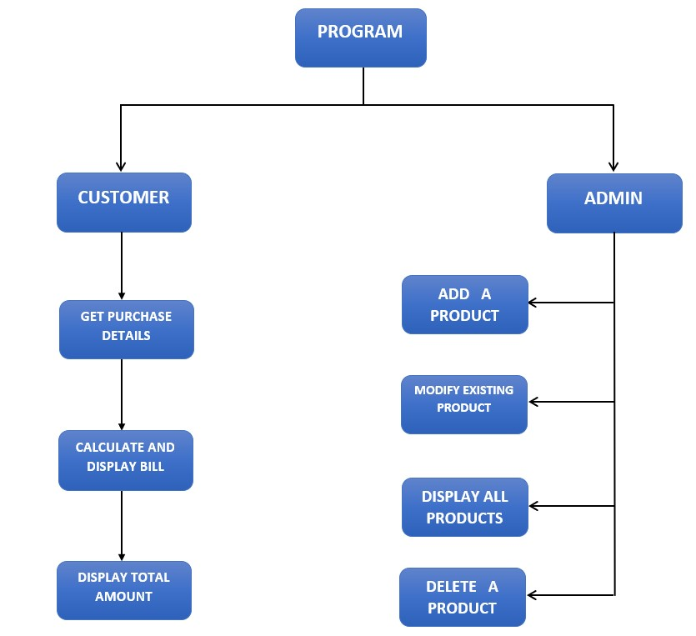
Flow Diagram

Slide 4
Methodology
Product details are stored in and retrieved from a text file.
Customer can view and purchase products through the user interface.
Total bill is displayed after purchase. The bill can be saved to a file if required.
Admin has access to add, modify, remove products.

Slide 5
Client Program
C# is chosen as client language.
For UI building we are using C#.

Slide 6
Language for dll
C++ is chosen as language for dll.

Slide 7
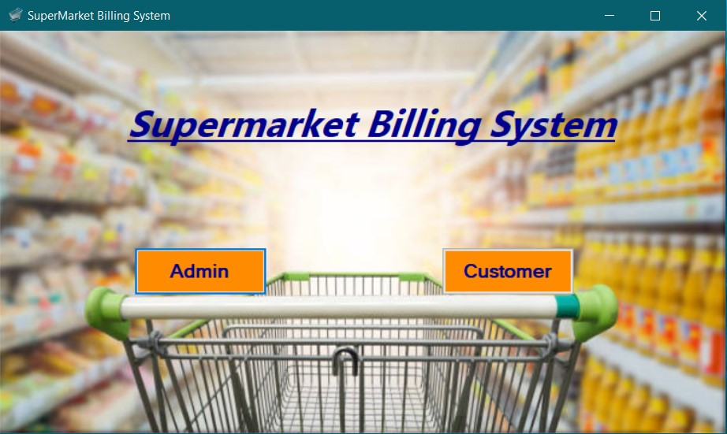
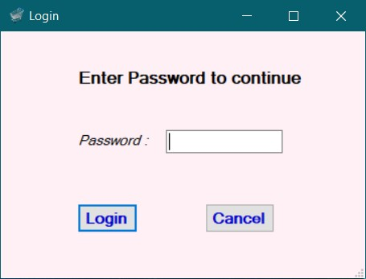
Results

Slide 8
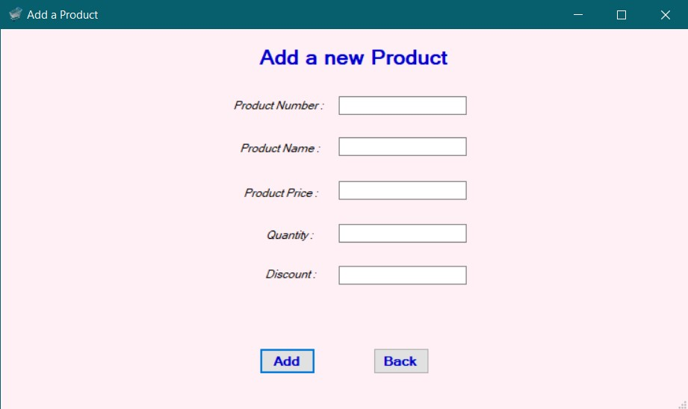
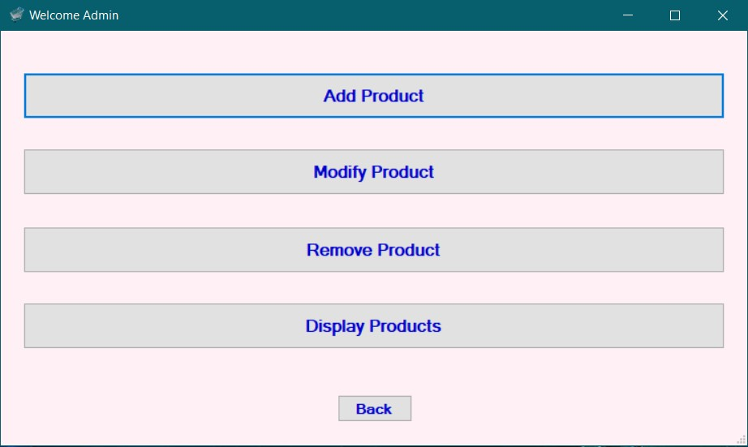
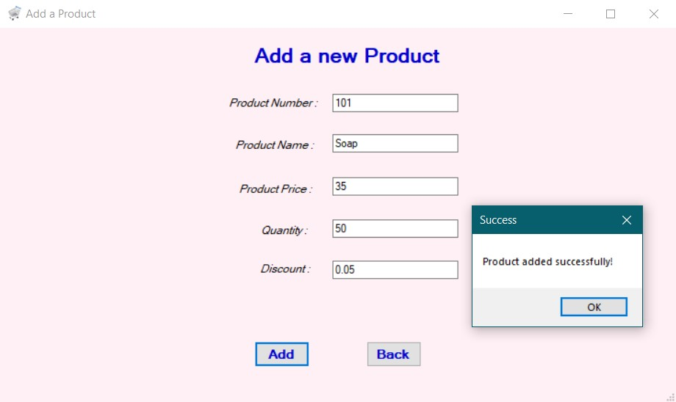

Slide 9
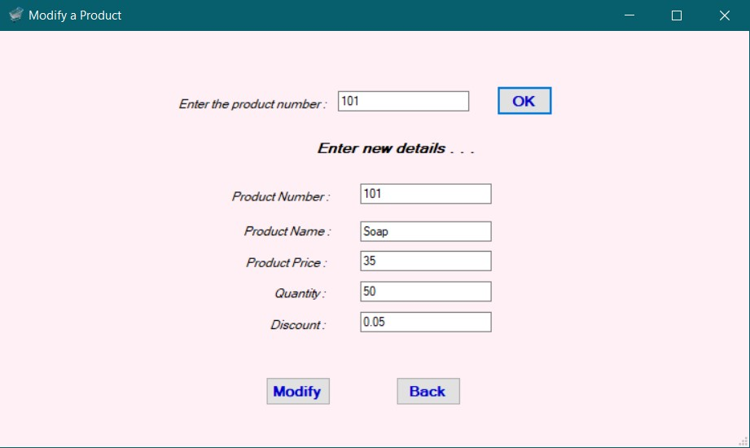
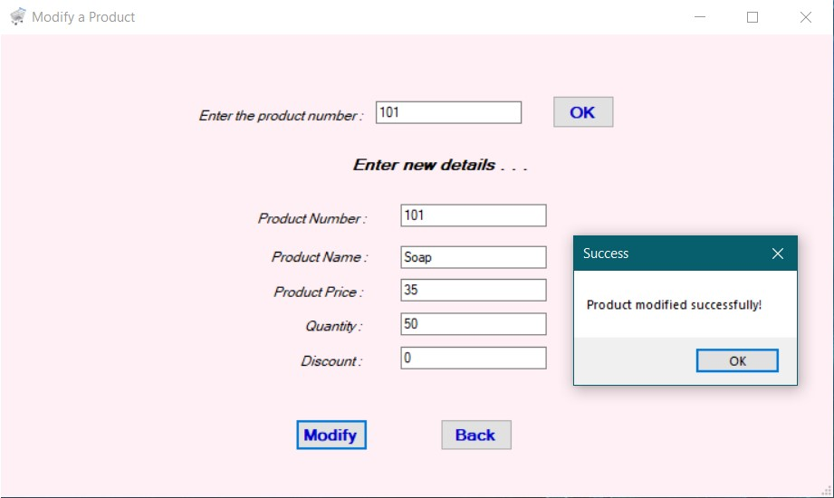

Slide 10
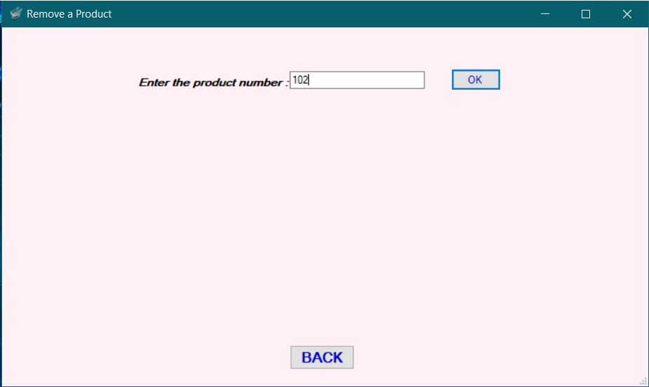
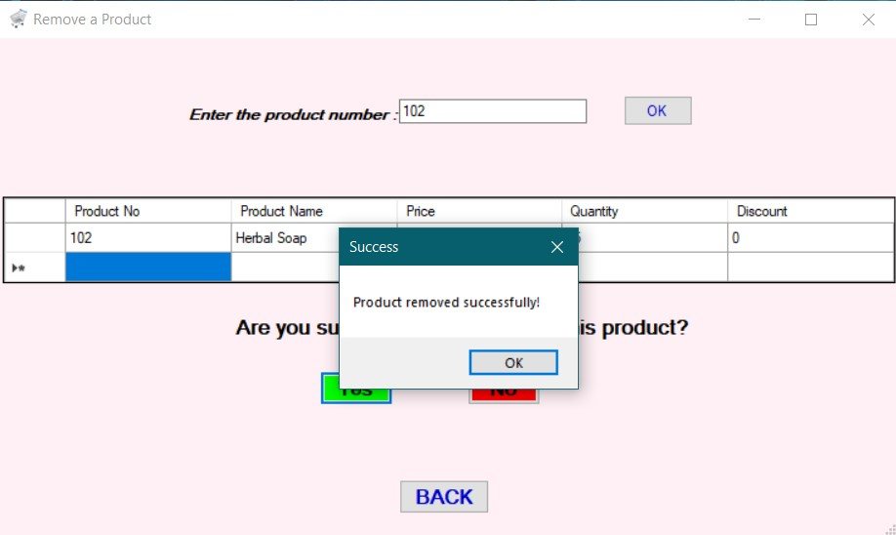
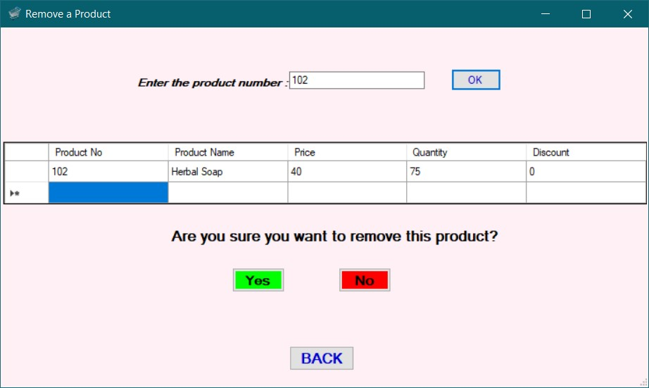

Slide 11
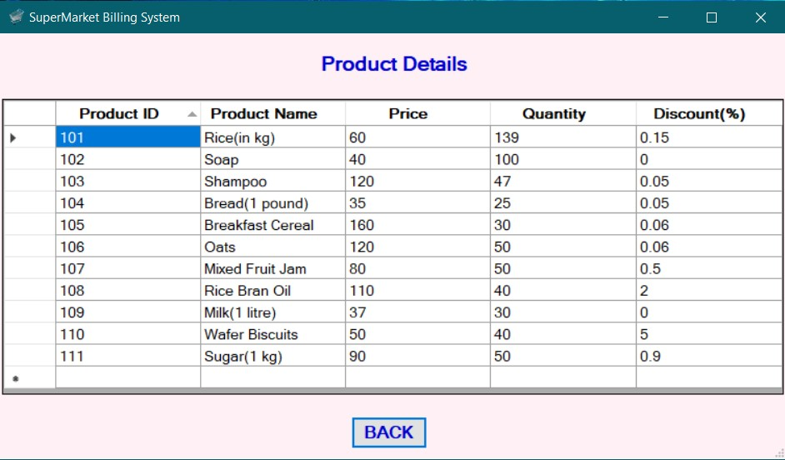

Slide 12
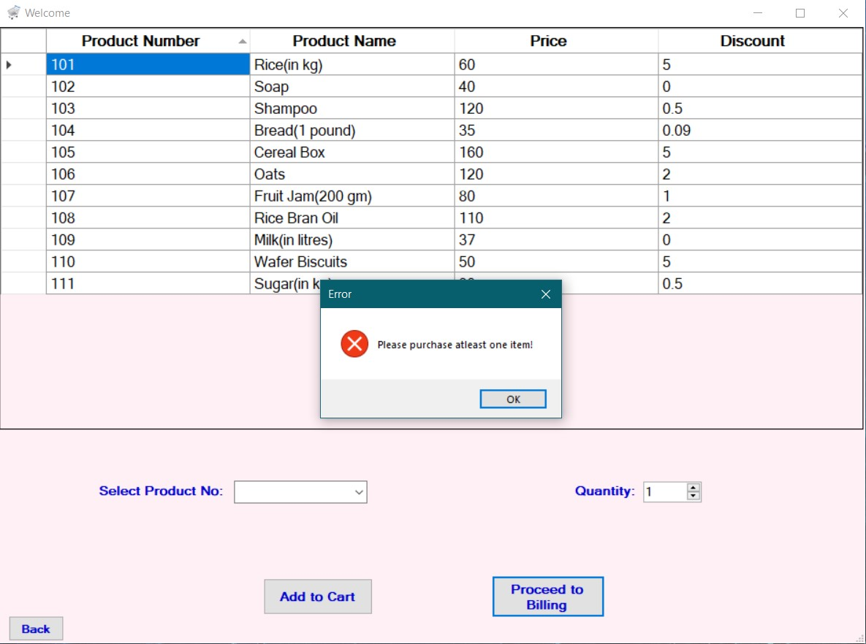
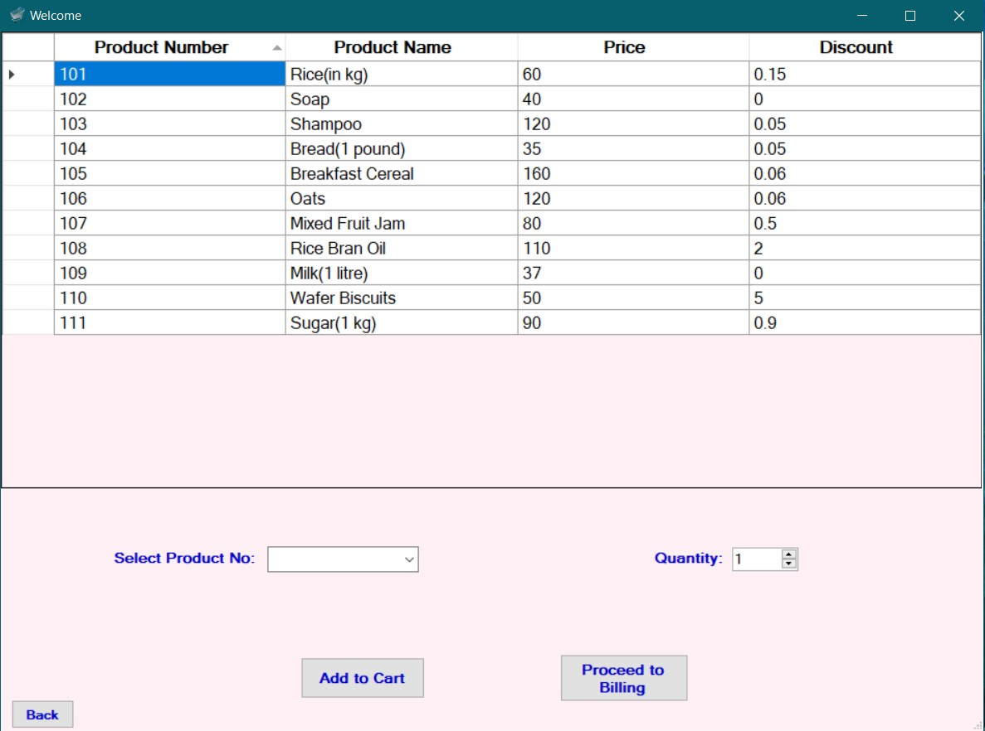
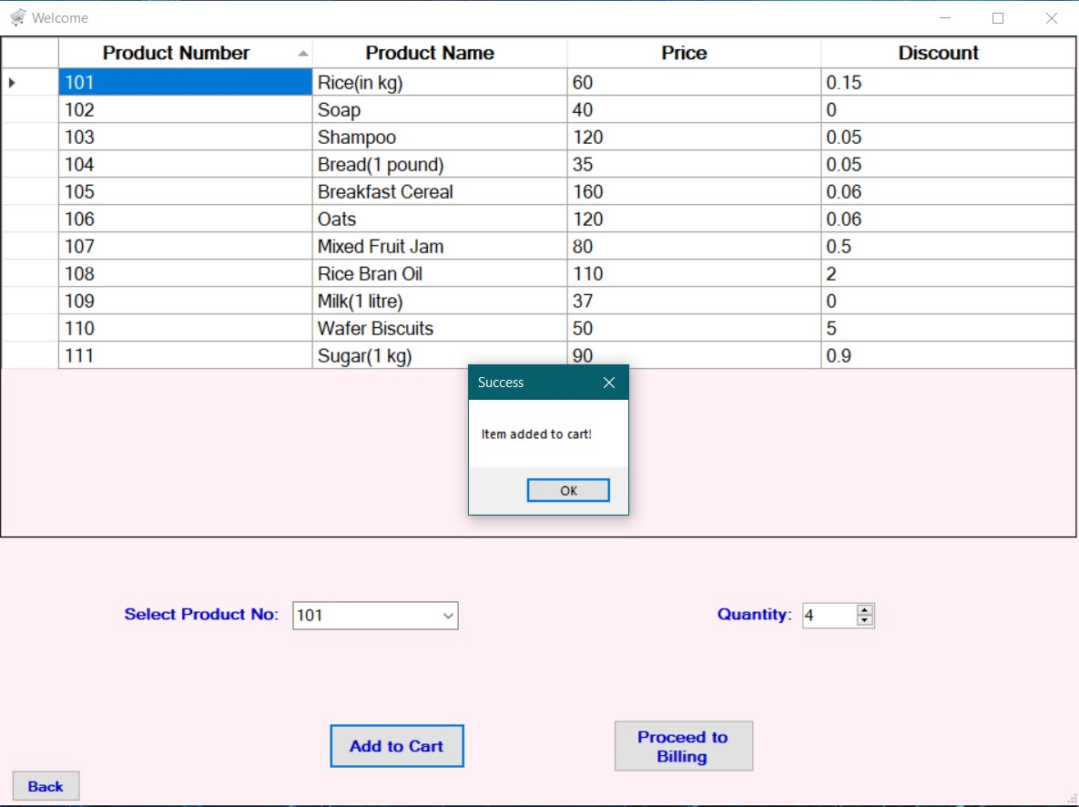

Slide 13
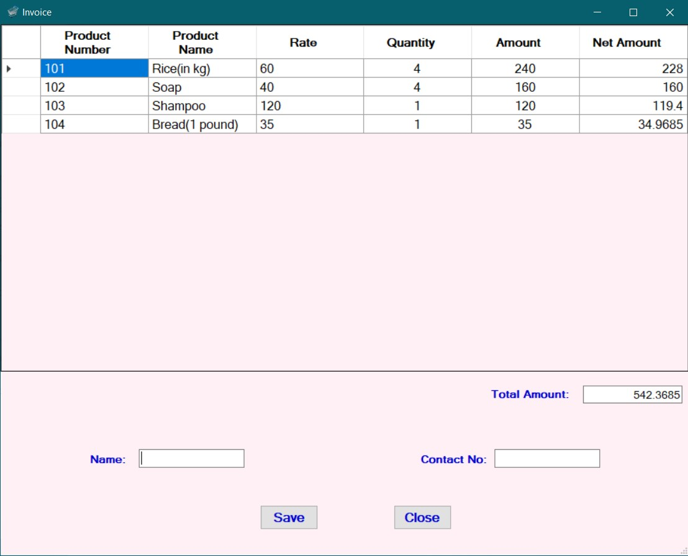
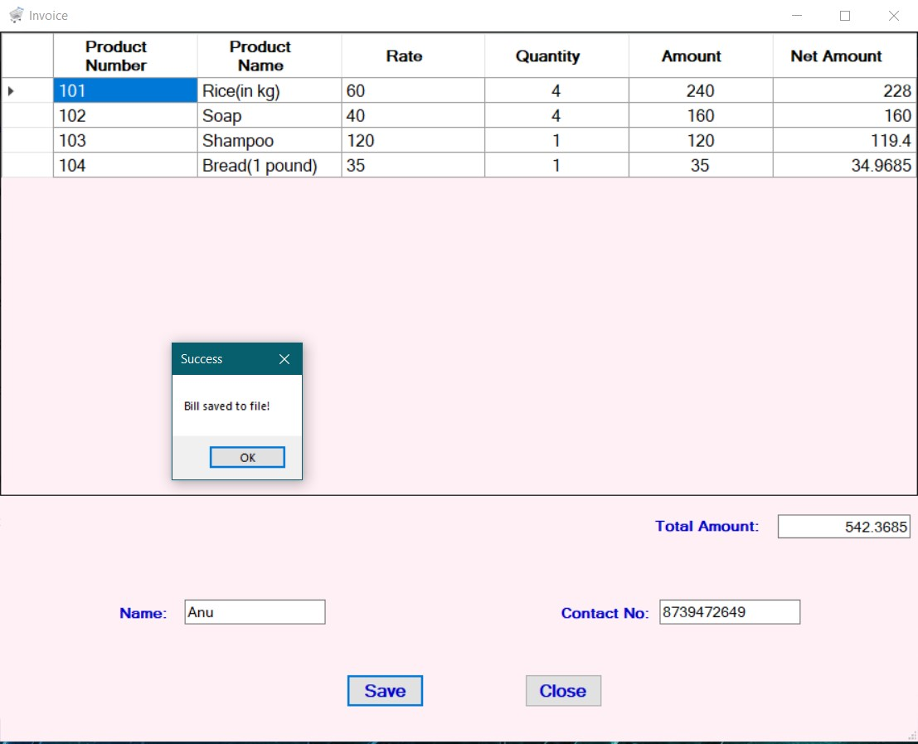

Slide 14


